Slide 1

SIMATS ENGINEERING csa0405 operating systems of file system implementation CAPSTONE PROJECT APRIL 2024
GUIDED BY:
Dr. yuvarani
PRESENTED BY:
T.ANOOPCHANDAR-192210244
k.jayaram-192210314
M.Mahesh-192210312

Slide 2


Slide 3


Slide 4
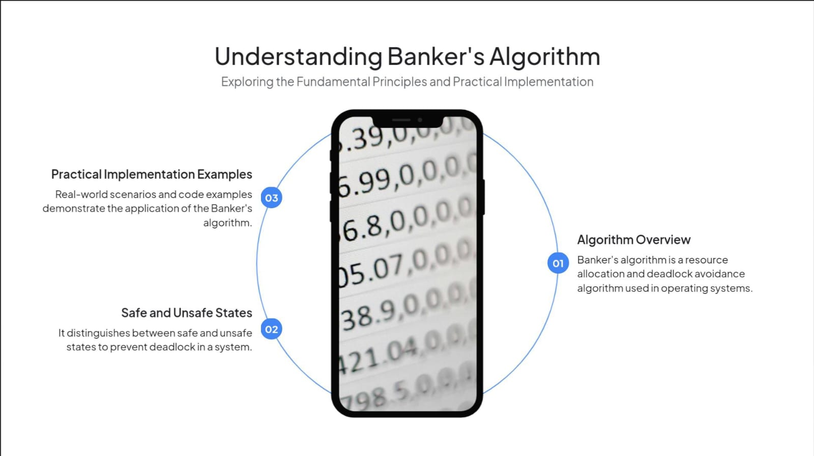

Slide 5


Slide 6
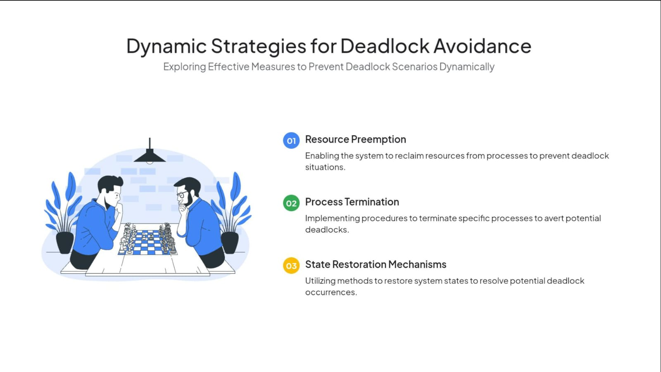

Slide 7


Slide 8
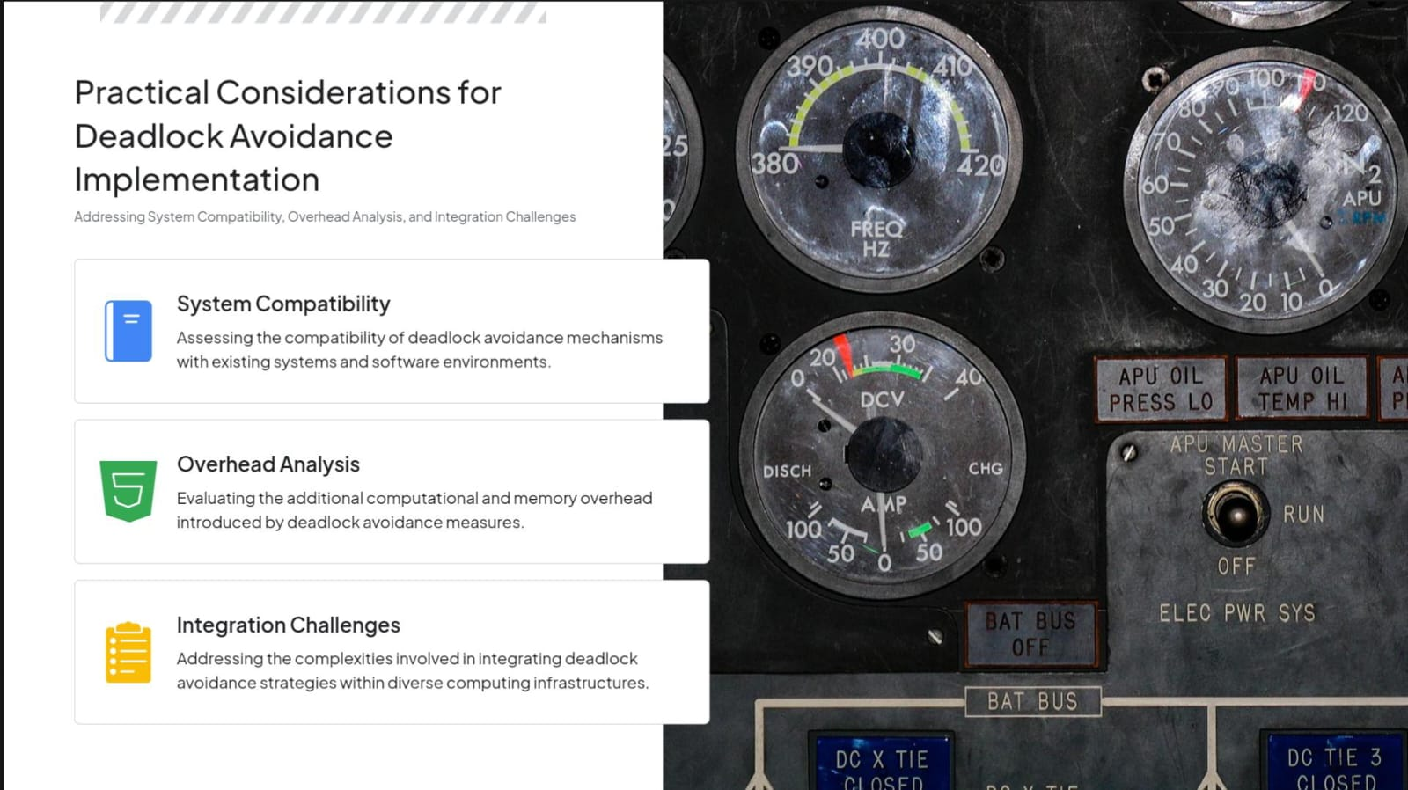

Slide 9
CODE AND OUTPUT:
CODE
#include<stdio.h>
#include<conio.h>
int max[100][100];
int alloc[100][100];
int need[100][100];
int avail[100];
int n,r;
void input();
void show();
void cal();
int main(){
int i,j;
printf("*** Banker's Algo ***\n");
input();
show();
cal();
getch();
return 0;
}
void input(){
int i,j;
printf("Enter the no of Processes\t");
scanf("%d",&n);
printf("Enter the no of resources instances\t");
scanf("%d",&r);
printf("Enter the Max Matrix\n");
for(i=0;i<n;i++){
for(j=0;j<r;j++){
scanf("%d",&max[i][j]);
}}
printf("Enter the Allocation Matrix\n");
for(i=0;i<n;i++){
for(j=0;j<r;j++){
scanf("%d",&alloc[i][j]);
}}
printf("Enter the available Resources\n");
for(j=0;j<r;j++){
scanf("%d",&avail[j]);
}}

Slide 10
void input(){
int i,j;
printf("Enter the no of Processes\t");
scanf("%d",&n);
printf("Enter the no of resources instances");
scanf("%d",&r);
printf("Enter the Max Matrix\n");
for(i=0;i<n;i++){
for(j=0;j<r;j++){
scanf("%d",&max[i][j]);
}}
printf("Enter the Allocation Matrix\n");
for(i=0;i<n;i++){
for(j=0;j<r;j++){
scanf("%d",&alloc[i][j]);
}}
printf("Enter the available Resources");
for(j=0;j<r;j++){
scanf("%d",&avail[j]);
}}
void show(){
int i,j;
printf("Process\t Allocation\t Max\t Available\t");
for(i=0;i<n;i++){
printf("\nP%d\t ",i+1);
for(j=0;j<r;j++){
printf("%d ",alloc[i][j]);
}
printf("\t");
for(j=0;j<r;j++){
printf("%d ",max[i][j]);
}
printf("\t");
if(i==0)
{
for(j=0;j<r;j++)
printf("%d ",avail[j]);
}}
}

Slide 11
void cal(){
int finish[100],temp,need[100][100],
flag=1,k,c1=0;
int safe[100],i,j;
for(i=0;i<n;i++){
finish[i]=0;
}
for(i=0;i<n;i++){
for(j=0;j<r;j++){
need[i][j]=max[i][j]-alloc[i][j];
}}
printf("\n");
while(flag)
{
flag=0;
for(i=0;i<n;i++){
int c=0;
for(j=0;j<r;j++){
if((finish[i]==0)&&(need[i][j]<=avail[j]))
{
c++;
if(c==r)
{
for(k=0;k<r;k++){
avail[k]+=alloc[i][j];
finish[i]=1;
flag=1;
}
printf("P%d->",i);
if(finish[i]==1){
i=n;
}}}}}}
for(i=0;i<n;i++){
if(finish[i]==1)
{
c1++;
}
else
{
printf("P%d->",i);
}
}
if(c1==n)
{
printf("\n The system is in safe state");

Slide 12
{
for(k=0;k<r;k++){
avail[k]+=alloc[i][j];
finish[i]=1;
flag=1;
}
printf("P%d->",i);
if(finish[i]==1)
{
i=n;
}}}}}}
for(i=0;i<n;i++){
if(finish[i]==1)
{
c1++;
}
else
{
printf("P%d->",i);
}
}
if(c1==n)
{
printf("\n The system is in safe state");
}
else
{
printf("\n Process are in dead lock");
printf("\n System is in unsafe state");
}
}

Slide 13
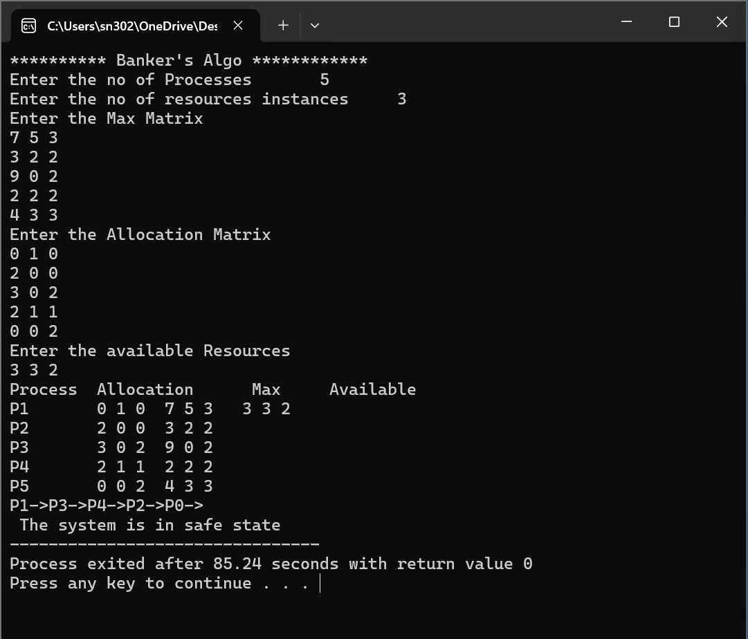
OUTPUT:

Slide 14
CONCLUSION:
In conclusion, the Banker's Algorithm is a vital resource allocation and deadlock avoidance technique used in operating systems. Its primary goal is to ensure the safe allocation of resources to processes while preventing deadlock, a situation where processes are unable to proceed due to circular dependency on resources. By dynamically analyzing the current state of the system and potential future resource requests, the algorithm optimizes resource utilization without compromising system safety. Through careful management of available resources, process requests, and system state, the Banker's Algorithm effectively maintains a balance between resource allocation and deadlock avoidance, contributing to the stability and efficiency of operating systems.

